Slide 1
C++ Programming: From Problem Analysis to Program Design, Fourth Edition
Chapter 7: User-Defined Functions II

Slide 2
Objectives
In this chapter, you will:
Learn how to construct and use void functions in a program
Discover the difference between value and reference parameters
Explore reference parameters and value-returning functions
Learn about the scope of an identifier
C++ Programming: From Problem Analysis to Program Design, Fourth Edition
‹#›

Slide 3
Objectives (continued)
Examine the difference between local and global identifiers
Discover static variables
Learn function overloading
Explore functions with default parameters
C++ Programming: From Problem Analysis to Program Design, Fourth Edition
‹#›

Slide 4
Void Functions
Void functions and value-returning functions have similar structures
Both have a heading part and a statement part
User-defined void functions can be placed either before or after the function main
If user-defined void functions are placed after the function main
The function prototype must be placed before the function main
C++ Programming: From Problem Analysis to Program Design, Fourth Edition
‹#›

Slide 5
Void Functions (continued)
A void function does not have a return type
return statement without any value is typically used to exit the function early
Formal parameters are optional
A call to a void function is a stand-alone statement
C++ Programming: From Problem Analysis to Program Design, Fourth Edition
‹#›

Slide 6
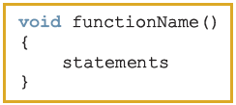

Void Functions without Parameters
Function definition syntax:
void is a reserved word
Function call syntax:
C++ Programming: From Problem Analysis to Program Design, Fourth Edition
‹#›

Slide 7
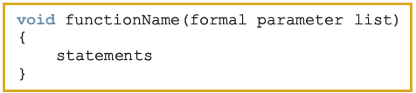

Void Functions with Parameters
Function definition syntax:
Formal parameter list syntax:
Function call syntax:
Actual parameter list syntax:
C++ Programming: From Problem Analysis to Program Design, Fourth Edition
‹#›

Slide 8
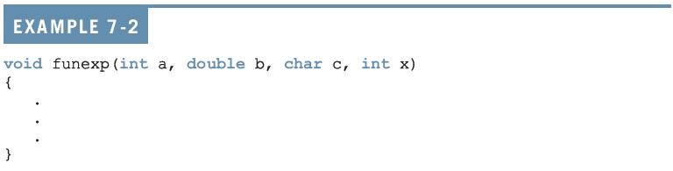
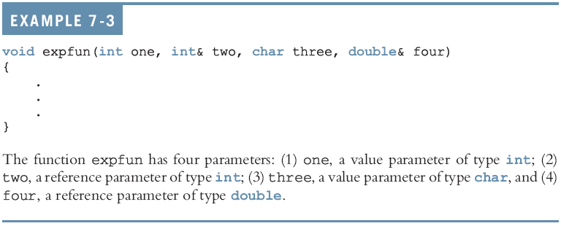
Void Functions with Parameters (continued)
C++ Programming: From Problem Analysis to Program Design, Fourth Edition
‹#›

Slide 9
Void Functions with Parameters (continued)
Value parameter: a formal parameter that receives a copy of the content of corresponding actual parameter
Reference parameter: a formal parameter that receives the location (memory address) of the corresponding actual parameter
C++ Programming: From Problem Analysis to Program Design, Fourth Edition
‹#›

Slide 10
Value Parameters
If a formal parameter is a value parameter
The value of the corresponding actual parameter is copied into it
The value parameter has its own copy of the data
During program execution
The value parameter manipulates the data stored in its own memory space
C++ Programming: From Problem Analysis to Program Design, Fourth Edition
‹#›

Slide 11
Reference Variables as Parameters
If a formal parameter is a reference parameter
It receives the memory address of the corresponding actual parameter
A reference parameter stores the address of the corresponding actual parameter
During program execution to manipulate data
The address stored in the reference parameter directs it to the memory space of the corresponding actual parameter
C++ Programming: From Problem Analysis to Program Design, Fourth Edition
‹#›

Slide 12
Reference Variables as Parameters (continued)
Reference parameters can:
Pass one or more values from a function
Change the value of the actual parameter
Reference parameters are useful in three situations:
Returning more than one value
Changing the actual parameter
When passing the address would save memory space and time
C++ Programming: From Problem Analysis to Program Design, Fourth Edition
‹#›

Slide 13
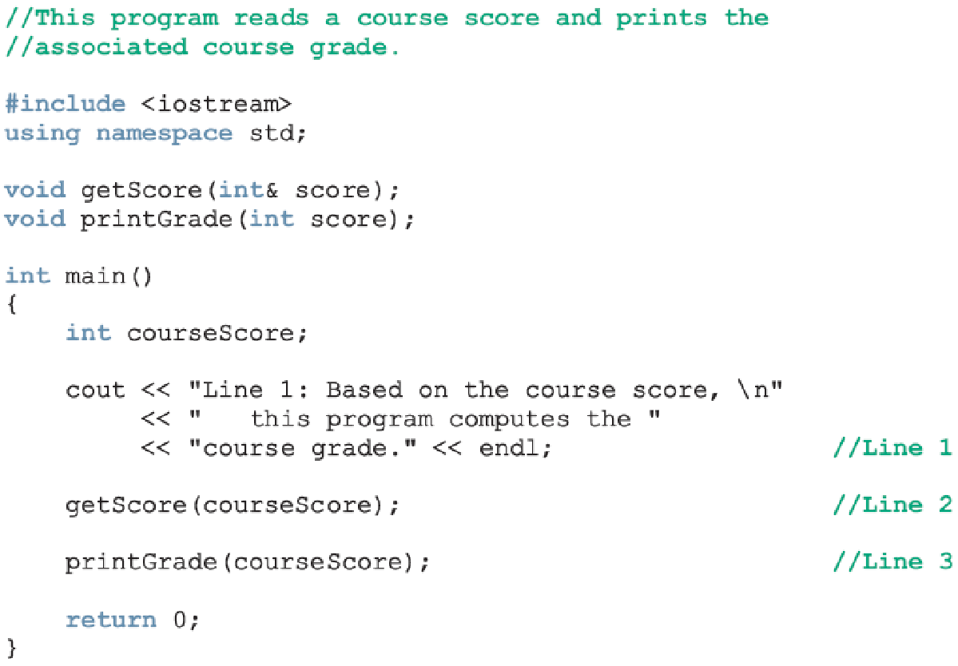
Calculate Grade
C++ Programming: From Problem Analysis to Program Design, Fourth Edition
‹#›

Slide 14
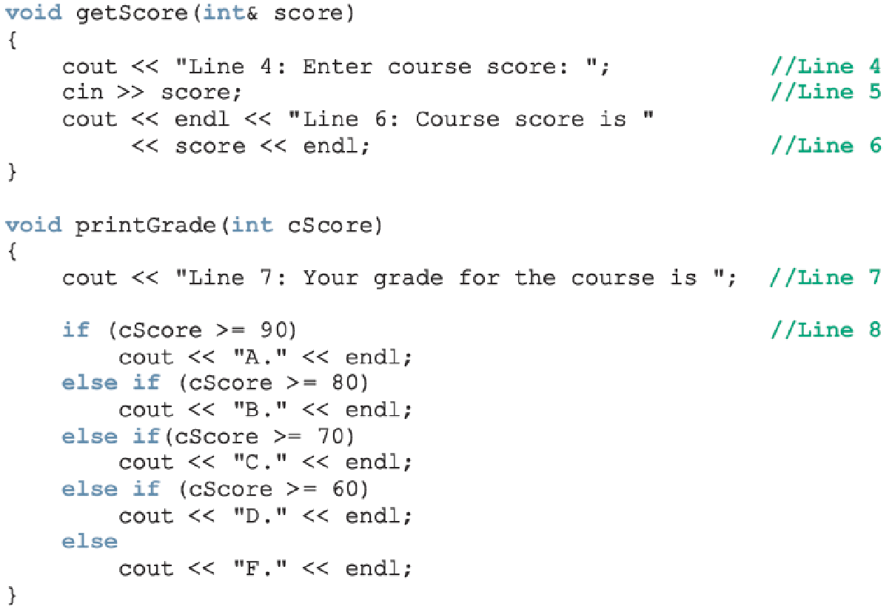
Calculate Grade (continued)
C++ Programming: From Problem Analysis to Program Design, Fourth Edition
‹#›

Slide 15

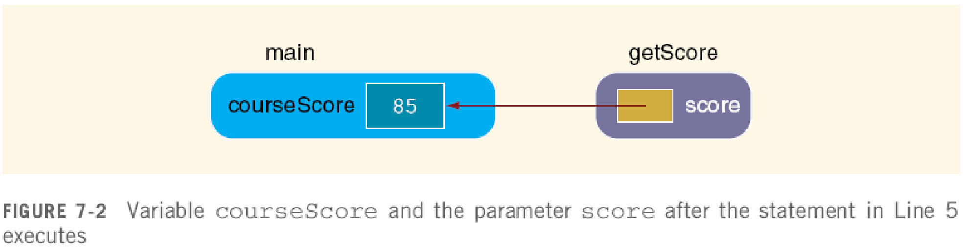

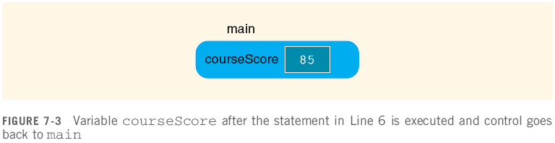



Slide 16
Value and Reference Parameters and Memory Allocation
When a function is called
Memory for its formal parameters and variables declared in the body of the function (called local variables) is allocated in the function data area
In the case of a value parameter
The value of the actual parameter is copied into the memory cell of its corresponding formal parameter
C++ Programming: From Problem Analysis to Program Design, Fourth Edition
‹#›

Slide 17
Value and Reference Parameters and Memory Allocation (continued)
In the case of a reference parameter
The address of the actual parameter passes to the formal parameter
Content of formal parameter is an address
During execution, changes made by the formal parameter permanently change the value of the actual parameter
Stream variables (e.g., ifstream) should be passed by reference to a function
C++ Programming: From Problem Analysis to Program Design, Fourth Edition
‹#›

Slide 18
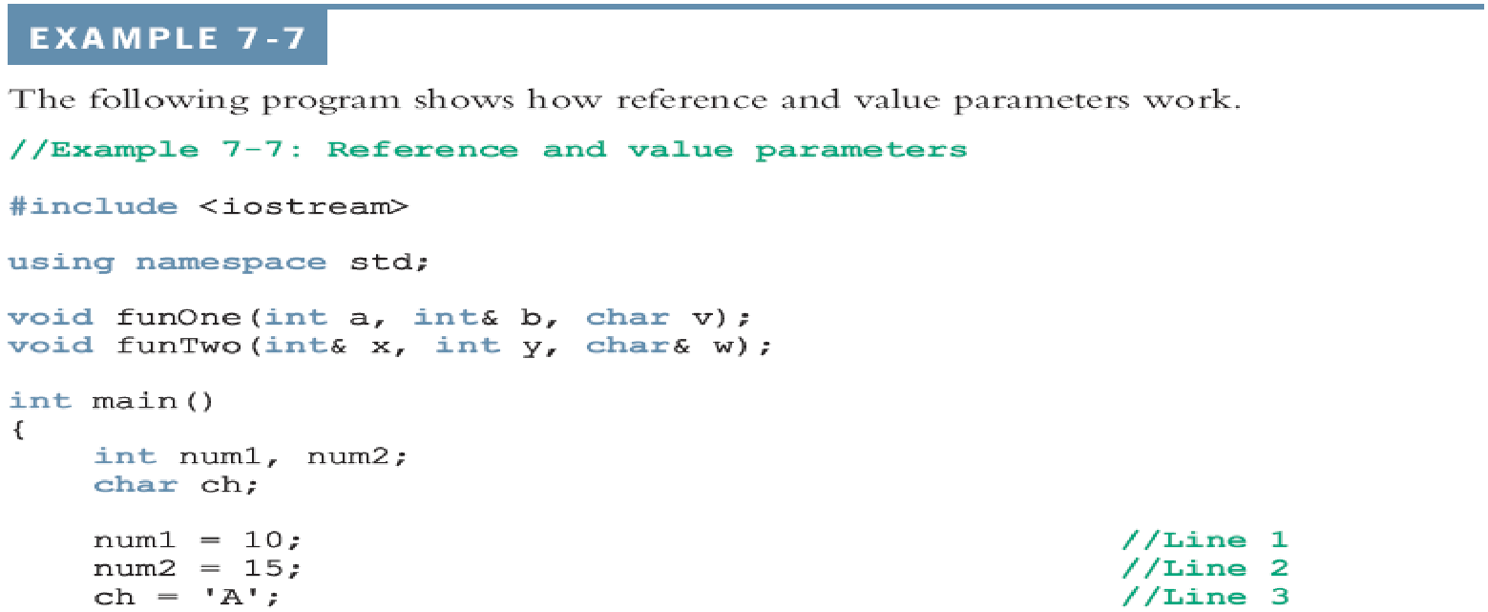
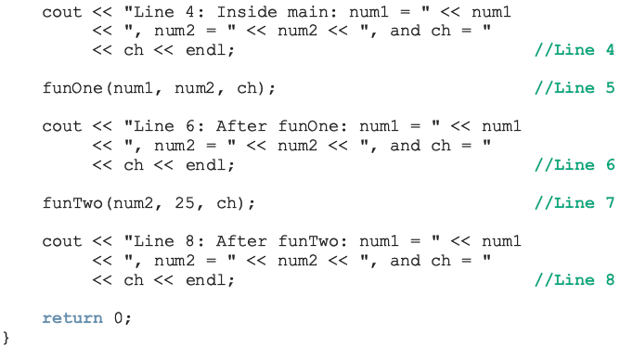

Slide 19
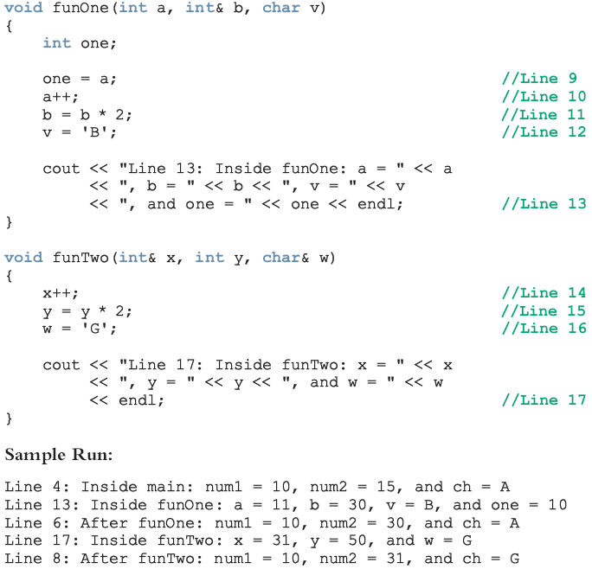

Slide 20

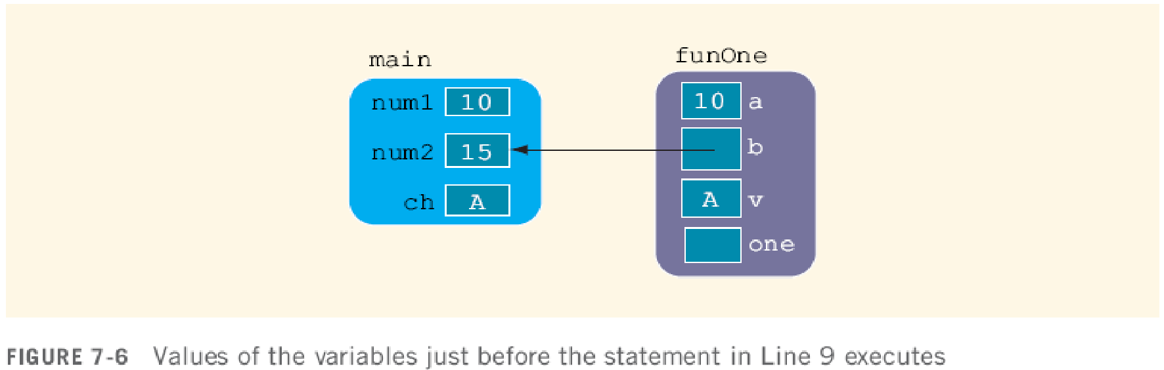
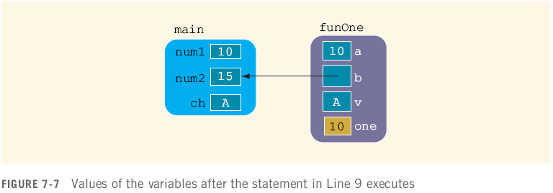

Slide 21




Slide 22



Slide 23




Slide 24
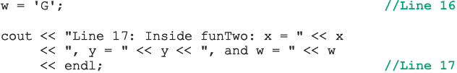



Slide 25
Reference Parameters and Value-Returning Functions
You can also use reference parameters in a value-returning function
Not recommended
By definition, a value-returning function returns a single value
This value is returned via the return statement
If a function needs to return more than one value, you should change it to a void function and use the appropriate reference parameters to return the values
C++ Programming: From Problem Analysis to Program Design, Fourth Edition
‹#›

Slide 26
Scope of an Identifier
The scope of an identifier refers to where in the program an identifier is accessible
Local identifier: identifiers declared within a function (or block)
Global identifier: identifiers declared outside of every function definition
C++ does not allow nested functions
The definition of one function cannot be included in the body of another function
C++ Programming: From Problem Analysis to Program Design, Fourth Edition
‹#›

Slide 27
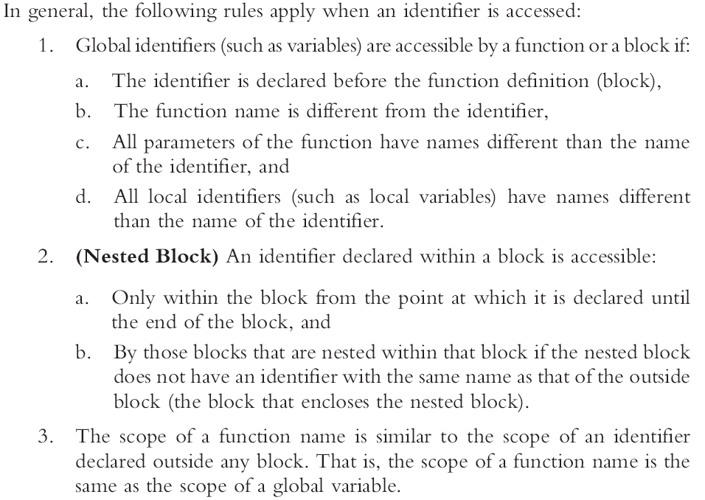

Slide 28
Scope of an Identifier (continued)
Some compilers initialize global variables to default values
The operator :: is called the scope resolution operator
By using the scope resolution operator
A global variable declared before the definition of a function (block) can be accessed by the function (or block) even if the function (or block) has an identifier with the same name as the variable
C++ Programming: From Problem Analysis to Program Design, Fourth Edition
‹#›

Slide 29
Scope of an Identifier (continued)
C++ provides a way to access a global variable declared after the definition of a function
In this case, the function must not contain any identifier with the same name as the global variable
C++ Programming: From Problem Analysis to Program Design, Fourth Edition
‹#›

Slide 30
Global Variables, Named Constants, and Side Effects
Using global variables has side effects
A function that uses global variables is not independent
If more than one function uses the same global variable and something goes wrong
It is difficult to find what went wrong and where
Problems caused in one area of the program may appear to be from another area
Global named constants have no side effects
C++ Programming: From Problem Analysis to Program Design, Fourth Edition
‹#›

Slide 31
Static and Automatic Variables
Automatic variable: memory is allocated at block entry and deallocated at block exit
By default, variables declared within a block are automatic variables
Static variable: memory remains allocated as long as the program executes
Variables declared outside of any block are static variables
Declare a static variable within a block by using the reserved word static
C++ Programming: From Problem Analysis to Program Design, Fourth Edition
‹#›

Slide 32

Static and Automatic Variables (continued)
The syntax for declaring a static variable is:
The statement
static int x;
declares x to be a static variable of the type int
Static variables declared within a block are local to the block
Their scope is the same as any other local identifier of that block
C++ Programming: From Problem Analysis to Program Design, Fourth Edition
‹#›

Slide 33
Function Overloading: An Introduction
In a C++ program, several functions can have the same name
This is called function overloading or overloading a function name
C++ Programming: From Problem Analysis to Program Design, Fourth Edition
‹#›

Slide 34
Function Overloading (continued)
Two functions are said to have different formal parameter lists if both functions have:
A different number of formal parameters, or
If the number of formal parameters is the same, then the data type of the formal parameters, in the order you list them, must differ in at least one position
C++ Programming: From Problem Analysis to Program Design, Fourth Edition
‹#›

Slide 35
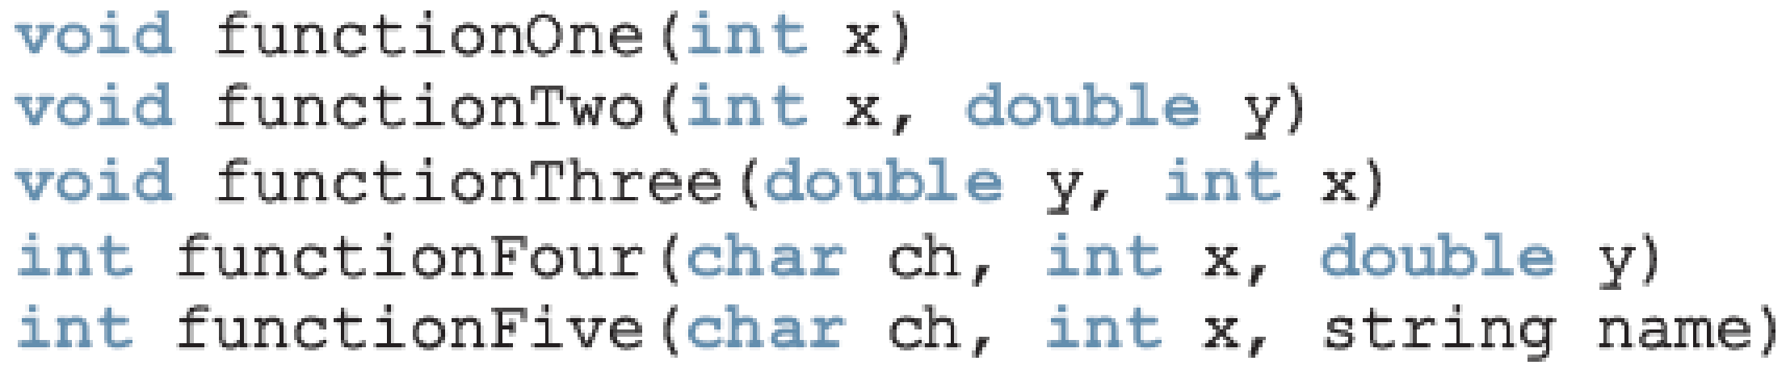
Function Overloading (continued)
The following functions all have different formal parameter lists:
The following functions have the same formal parameter list:
C++ Programming: From Problem Analysis to Program Design, Fourth Edition
‹#›

Slide 36
Function Overloading (continued)
Function overloading: creating several functions with the same name
The signature of a function consists of the function name and its formal parameter list
Two functions have different signatures if they have either different names or different formal parameter lists
Note that the signature of a function does not include the return type of the function
C++ Programming: From Problem Analysis to Program Design, Fourth Edition
‹#›

Slide 37
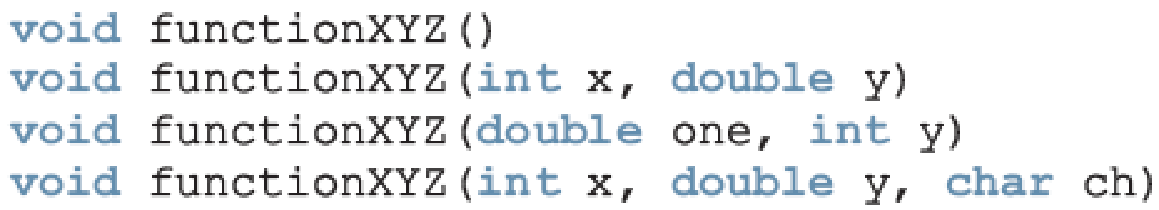
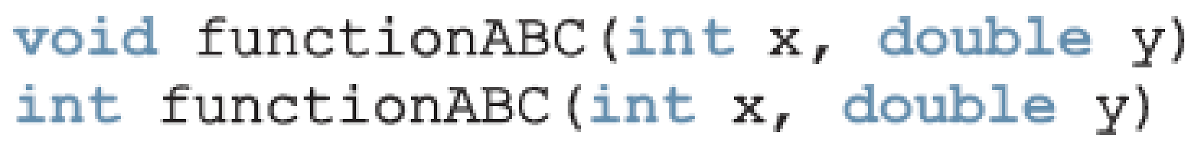
Function Overloading (continued)
Correct function overloading:
Syntax error:
C++ Programming: From Problem Analysis to Program Design, Fourth Edition
‹#›

Slide 38
Functions with Default Parameters
In a function call, the number of actual and formal parameters must be the same
C++ relaxes this condition for functions with default parameters
You specify the value of a default parameter when the function name appears for the first time (e.g., in the prototype)
If you do not specify the value of a default parameter, the default value is used
C++ Programming: From Problem Analysis to Program Design, Fourth Edition
‹#›

Slide 39
Functions with Default Parameters (continued)
All default parameters must be the rightmost parameters of the function
In a function call where the function has more than one default parameter and a value to a default parameter is not specified:
You must omit all of the arguments to its right
Default values can be constants, global variables, or function calls
However, you cannot assign a constant value as a default value to a reference parameter
C++ Programming: From Problem Analysis to Program Design, Fourth Edition
‹#›

Slide 40
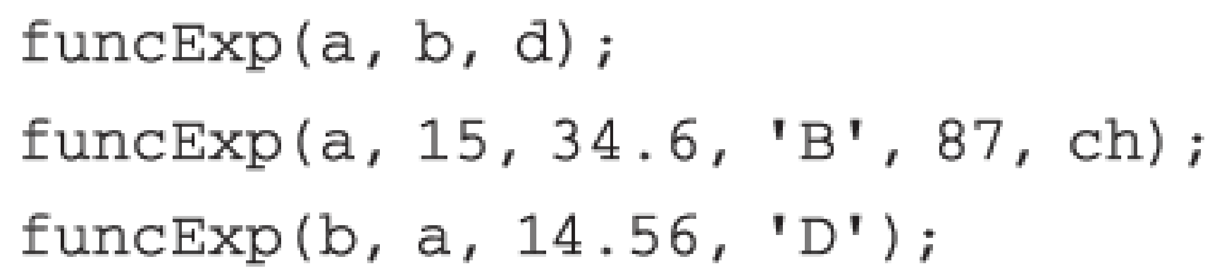
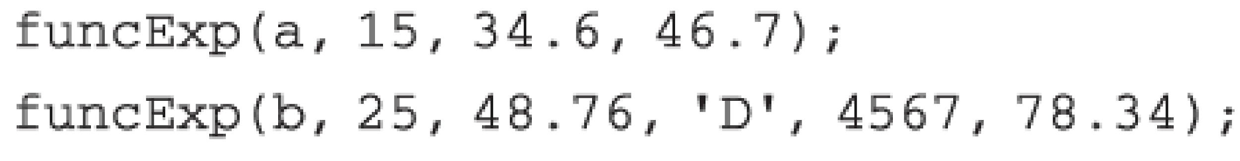
Functions with Default Parameters (continued)
Consider the following prototype:
Assume:
a, b are int, ch is char, d is double
Examples of legal calls:
Examples of illegal calls:
C++ Programming: From Problem Analysis to Program Design, Fourth Edition
‹#›

Slide 41
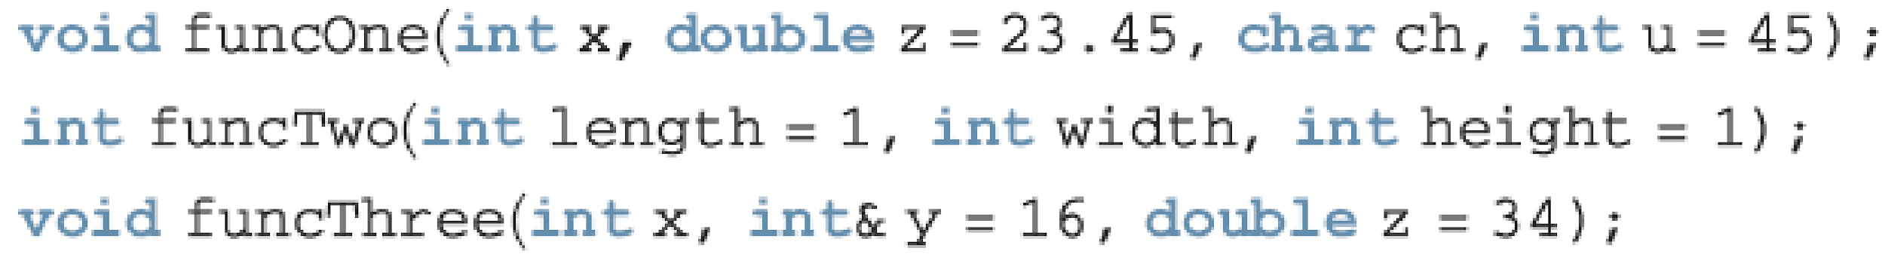
Functions with Default Parameters (continued)
Examples of illegal function prototypes with default parameters:
C++ Programming: From Problem Analysis to Program Design, Fourth Edition
‹#›

Slide 42
Programming Example: Classify Numbers
In this example, we use functions to rewrite the program that determines the number of odds and evens from a given list of integers
Main algorithm remains the same:
Initialize variables, zeros, odds, evens to 0
Read a number
If number is even, increment the even count
If number is also zero, increment the zero count; else increment the odd count
Repeat Steps 2-3 for each number in the list
C++ Programming: From Problem Analysis to Program Design, Fourth Edition
‹#›

Slide 43
Programming Example: Classify Numbers (continued)
The program functions include:
initialize: initialize the variables, such as zeros, odds, and evens
getNumber: get the number
classifyNumber: determine if number is odd or even (and whether it is also zero); this function also increments the appropriate count
printResults: print the results
C++ Programming: From Problem Analysis to Program Design, Fourth Edition
‹#›

Slide 44
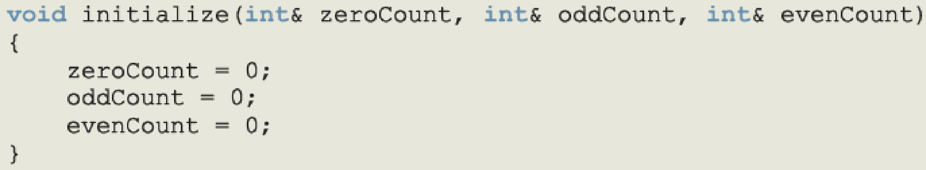
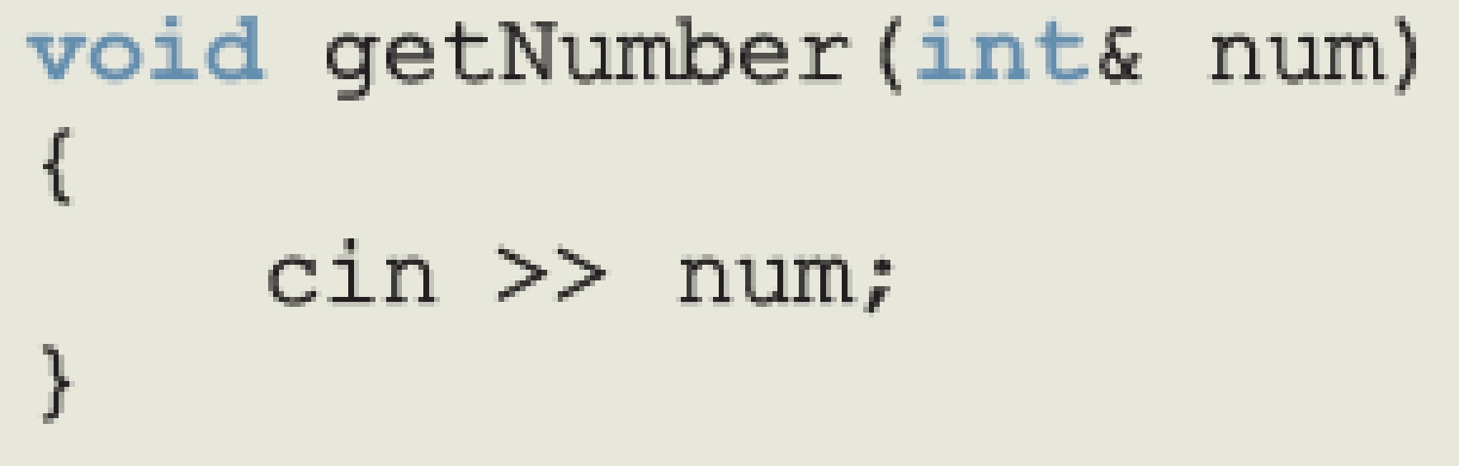
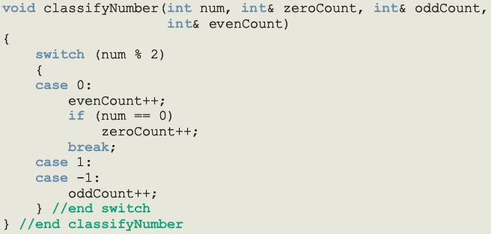
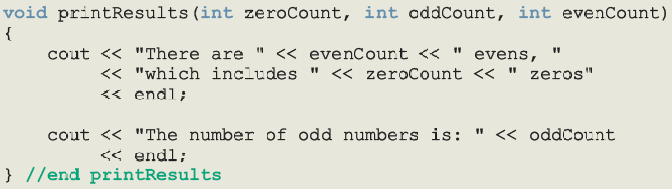

Slide 45
Programming Example: Main Algorithm
Call initialize to initialize variables
Prompt the user to enter 20 numbers
For each number in the list
Call getNumber to read a number
Output the number
Call classifyNumber to classify the number and increment the appropriate count
Call printResults to print the final results
C++ Programming: From Problem Analysis to Program Design, Fourth Edition
‹#›

Slide 46
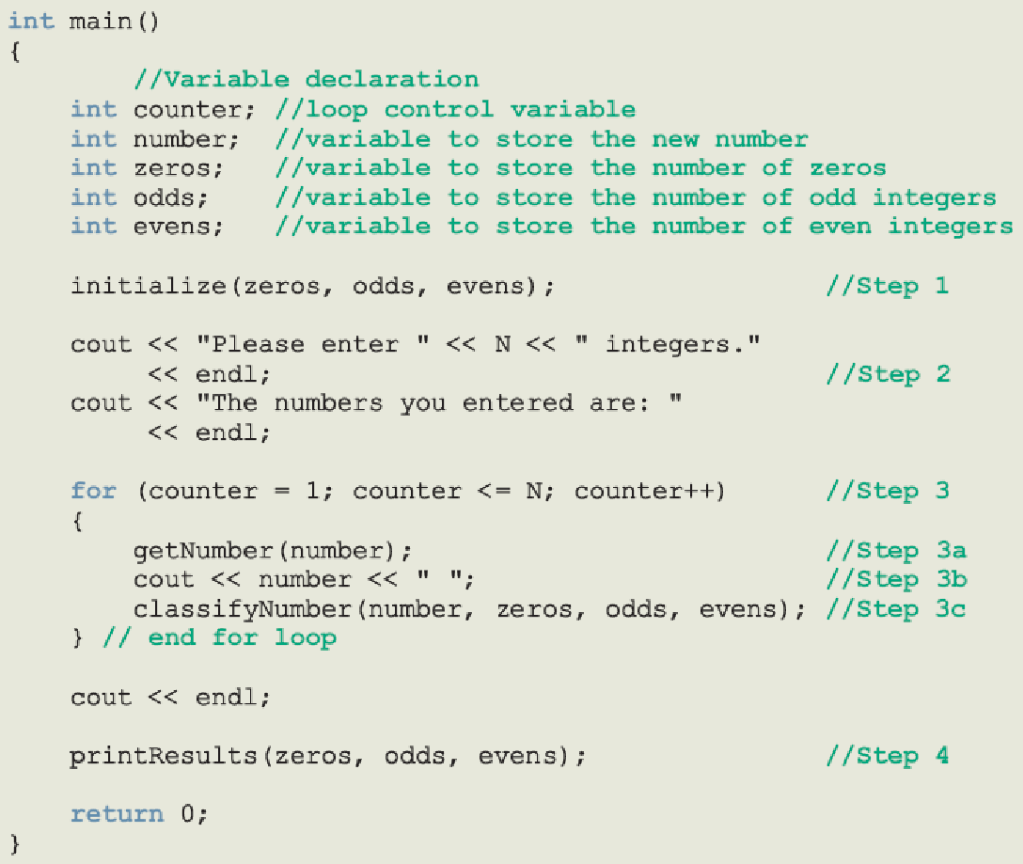

Slide 47
string Type
To use the data type string, the program must include the header file string
The statement:
string name = "William Jacob";
declares name to be a string variable and also initializes name to "William Jacob"
The first character, 'W', is in position 0
The second character, 'i', is in position 1
name is capable of storing any size string
C++ Programming: From Problem Analysis to Program Design, Fourth Edition
‹#›

Slide 48
string Type (continued)
Binary operator + and the array subscript operator [], have been defined for the data type string
+ performs the string concatenation operation
Example:
str1 = "Sunny";
str2 = str1 + " Day";
stores "Sunny Day" into str2
C++ Programming: From Problem Analysis to Program Design, Fourth Edition
‹#›

Slide 49
Additional string Operations
length
size
find
substr
swap
C++ Programming: From Problem Analysis to Program Design, Fourth Edition
‹#›

Slide 50

length Function
Returns the number of characters currently in the string
Syntax:
where strVar is variable of the type string
length returns an unsigned integer
The value returned can be stored in an integer variable
C++ Programming: From Problem Analysis to Program Design, Fourth Edition
‹#›

Slide 51
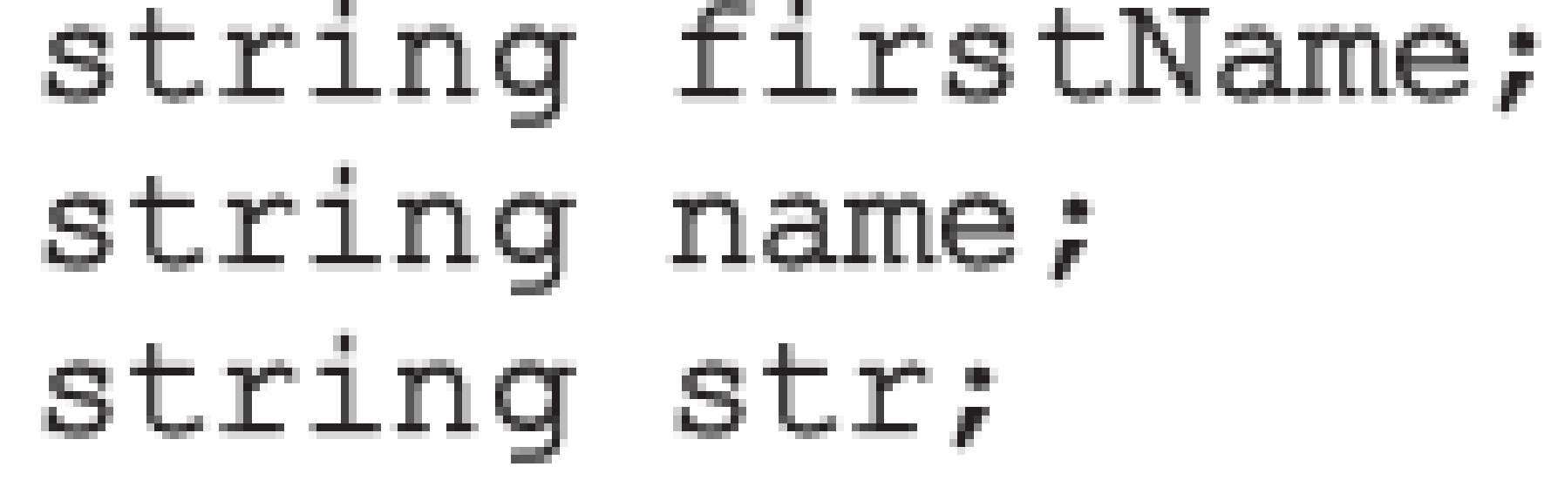
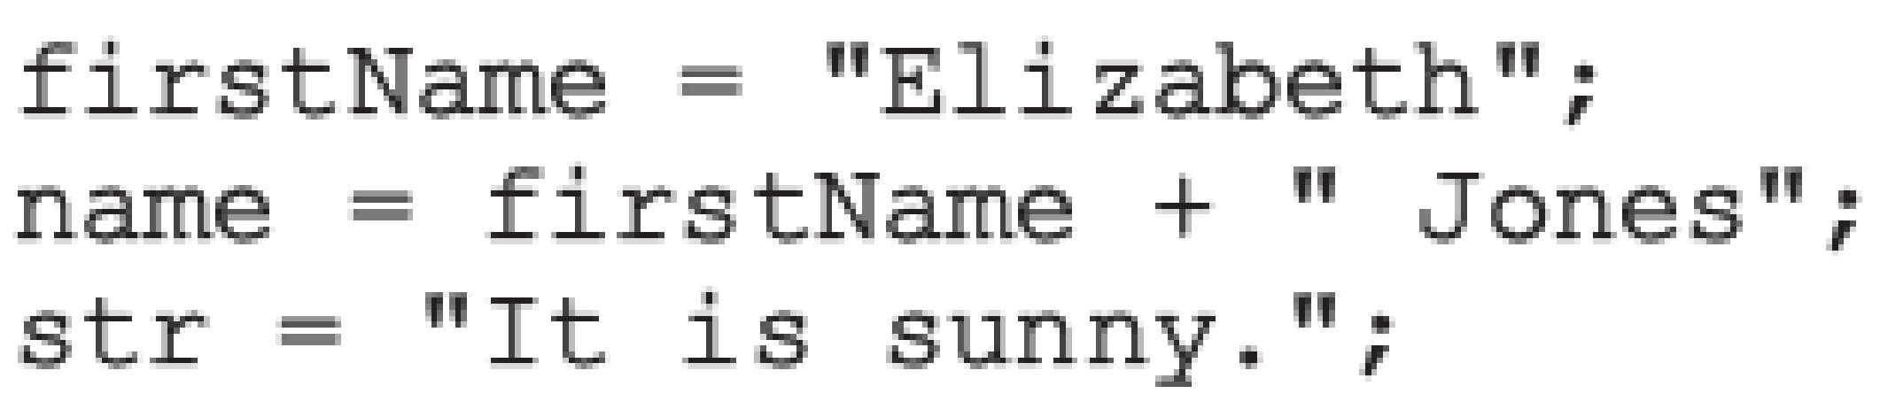
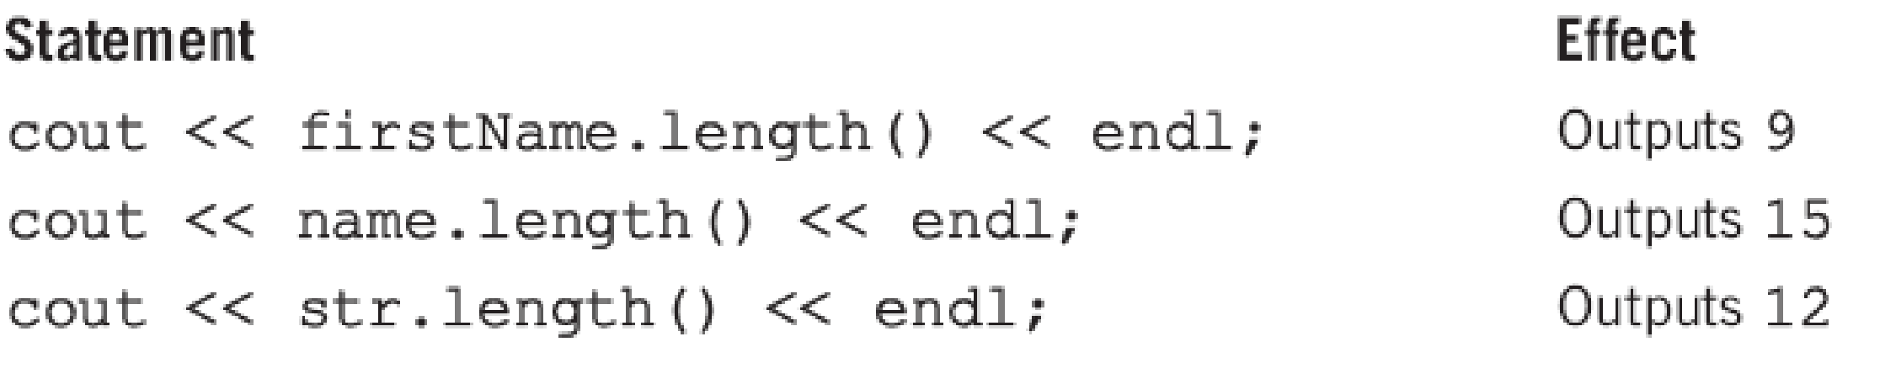
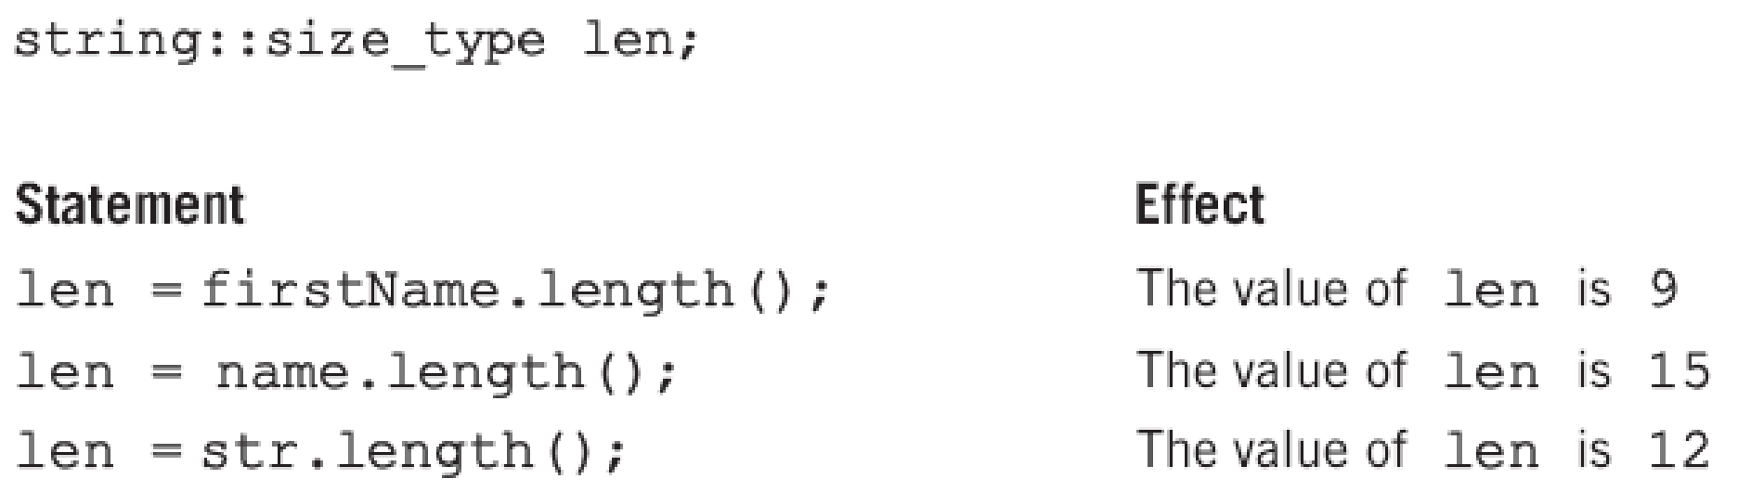

Slide 52

size Function
size is the same as the function length
Both functions return the same value
Syntax:
where strVar is variable of the type string
As in the case of the function length, the function size has no arguments
C++ Programming: From Problem Analysis to Program Design, Fourth Edition
‹#›

Slide 53


find Function
Searches a string for the first occurrence of a particular substring
Returns an unsigned integer value of type string::size_type
Or string::npos if unsuccessful
Syntax:
strExp can be a string or a character
C++ Programming: From Problem Analysis to Program Design, Fourth Edition
‹#›

Slide 54
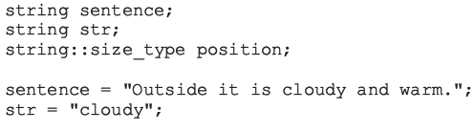
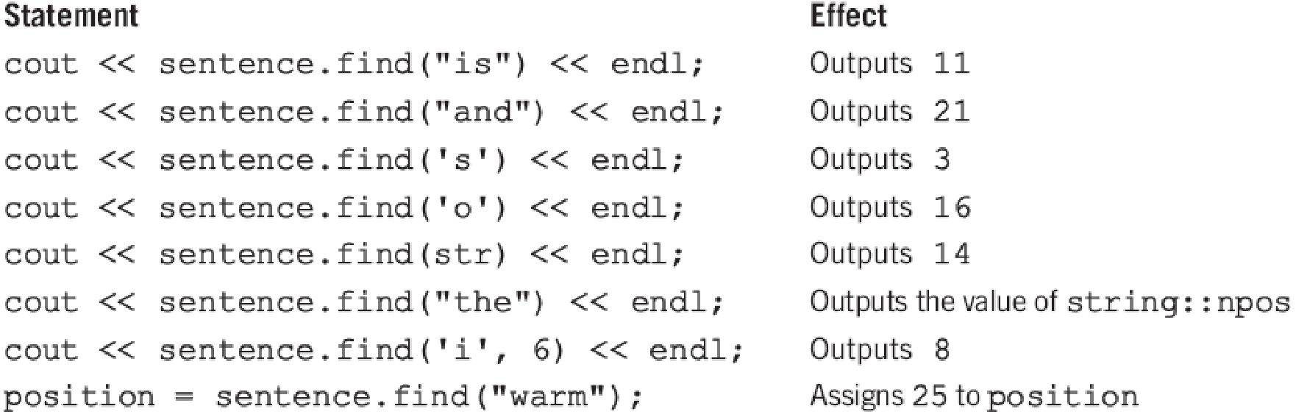
find Function (continued)
C++ Programming: From Problem Analysis to Program Design, Fourth Edition
‹#›

Slide 55

substr Function
Returns a particular substring of a string
Syntax:
expr1 and expr2 are expressions evaluating to unsigned integers
expr1 specifies a position within the string (starting position of the substring)
expr2 specifies the length of the substring to be returned
C++ Programming: From Problem Analysis to Program Design, Fourth Edition
‹#›

Slide 56
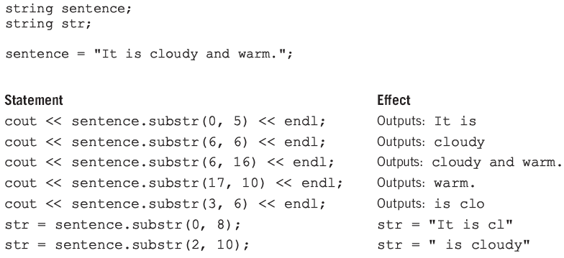
substr Function (continued)
C++ Programming: From Problem Analysis to Program Design, Fourth Edition
‹#›

Slide 57

swap Function
Interchanges contents of two string variables
Syntax:
where strVar1 and strVar2 are string variables
Suppose you have the following statements:
string str1 = "Warm";
string str2 = "Cold";
After str1.swap(str2); executes, the value of str1 is "Cold" and the value of str2 is "War"
C++ Programming: From Problem Analysis to Program Design, Fourth Edition
‹#›

Slide 58
Summary
Void function: does not have a data type
A return statement without any value can be used in a void function to exit it early
The heading starts with the word void
To call the function, you use the function name together with the actual parameters in a stand-alone statement
Two types of formal parameters:
Value parameters
Reference parameters
C++ Programming: From Problem Analysis to Program Design, Fourth Edition
‹#›

Slide 59
Summary (continued)
A value parameter receives a copy of its corresponding actual parameter
A reference parameter receives the memory address of its corresponding actual parameter
If a formal parameter needs to change the value of an actual parameter, you must declare this formal parameter as a reference parameter in the function heading
C++ Programming: From Problem Analysis to Program Design, Fourth Edition
‹#›

Slide 60
Summary (continued)
Variables declared within a function (or block) are called local variables
Variables declared outside of every function definition (and block) are global variables
Automatic variable: variable for which memory is allocated on function/block entry and deallocated on function/block exit
Static variable: memory remains allocated throughout the execution of the program
C++ functions can have default parameters
C++ Programming: From Problem Analysis to Program Design, Fourth Edition
‹#›

